Slide 1
Seismic reflection data Lecture 5
Dr Rebecca (Becky) Bell and Raul Adriaensen
2nd floor, office 2.37a
rebecca.bell@imperial.ac.uk

Slide 2
Module outline
Day 2 morning- Visualising and interpreting seismic data
Lecture 4: The SEGY data convention and where to find data
Lecture 5: How to interpret seismic data
Lecture 6: Seismic attribute analysis and machine learning (future outlook)
Day 2 afternoon- Exercises
Exercise 3: Reading SEGY data and visualizing 3D data
Exercise 4: Calculating seismic attributes
Quick introduction to the assessment on 3rd Dec

Slide 3
Lecture outline
Objective of lecture 5:
Conventional seismic interpretation and geological features imaged in seismic data
1) Limitations of conventional seismic interpretation
2) Common geological features that may be observed in near-surface
seismic data used for environmental applications
3) Conventional seismic interpretation ‘deliverables’

Slide 4
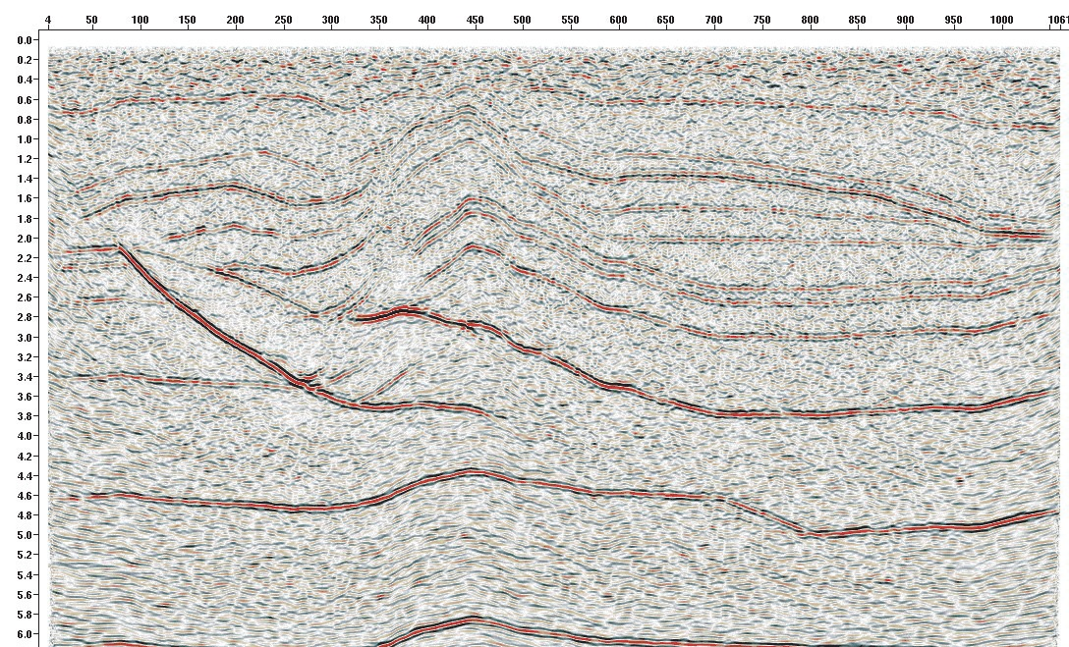
Seismic interpretation: Where to start?
CDP number
TWTT (s)
Time-migrated seismic section
Bond et al. 2007

Slide 5

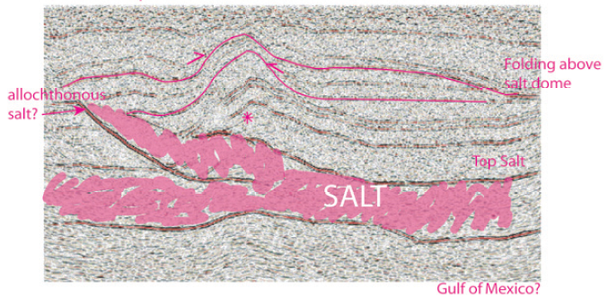
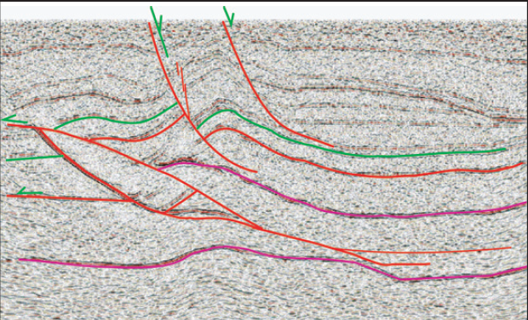
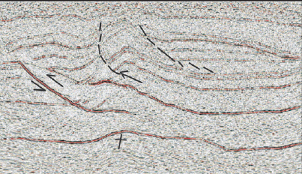
Uncertainty in seismic interpretation
Seismic interpretation is subjective- different people will interpret the same section differently
The seismic section on the previous slide was given to 412 people to interpret- ranging
from students to experienced academics and industry geologists
Salt?
Normal faults?
Thrust faults?
Bond et al. 2007

Slide 6
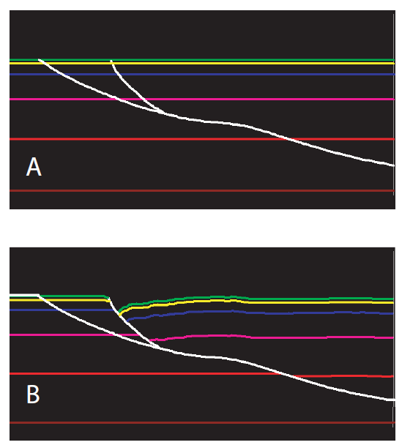
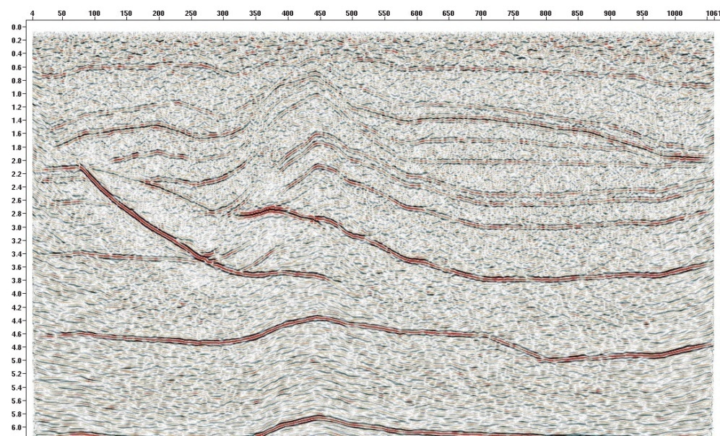
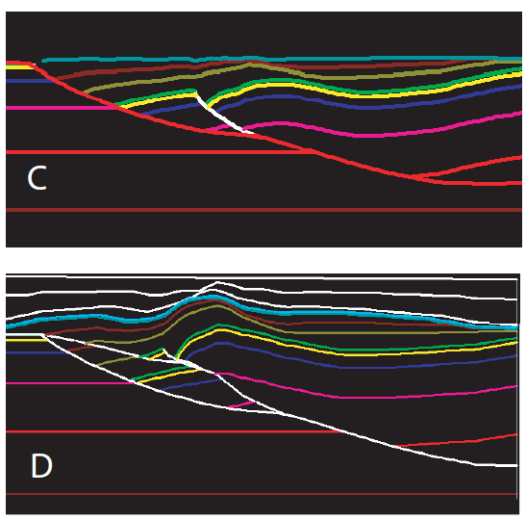
Uncertainty in seismic interpretation
Bond et al. 2007
The principle of Seismic-stratigraphy has provided geoscientists with a framework to interpret seismic data since 1977
More recent studies show that seismic interpretation can be improved by attempting to restore the geological evolution of the area based on your interpretation (to prove geologically valid)
However, conventional seismic interpretation is still very subjective

Slide 7
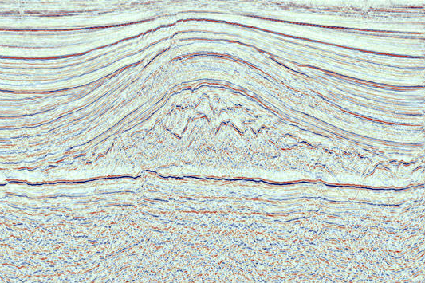
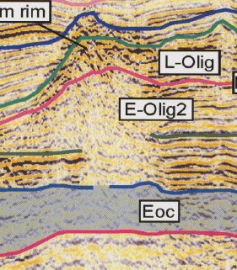
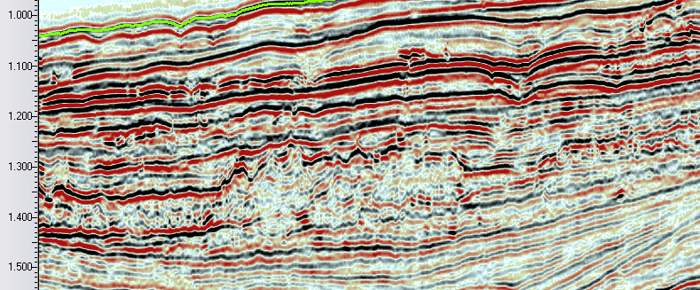
Non-unique seismic facies
One of the difficulties of working with seismic data is that different geological features can look
similar. The way geological features look in seismic data (their ‘seismic facies’) is non-unique
This is also a challenge for any deep learning attempts to automate seismic interpretation
(we will come back to this in lecture 6)
1
The seismic facies in each green
box would be described as
”low amplitude, chaotic reflections”
But the three images show 1) salt,
2) debris flows and 3) carbonates
3
2
From AAPG Studies in Geology 49

Slide 8
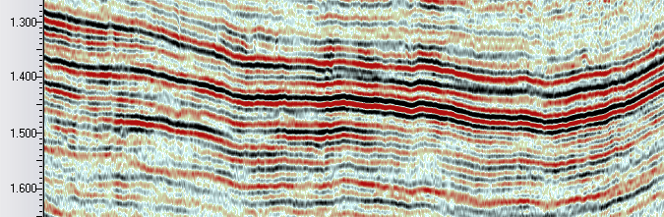
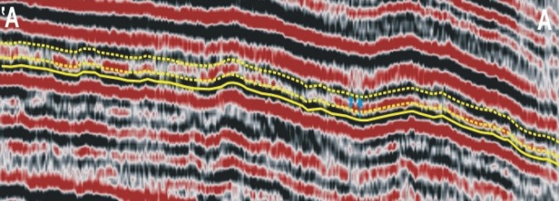
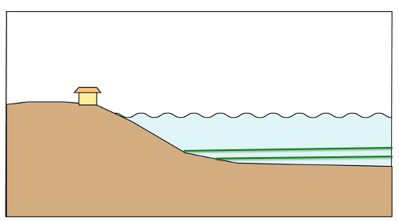
Geological features in seismic data
Vertical aggradation
Sedimentation in areas of high relative sea-level (ie there is lots of accommodation space for sediments to fill)
Image courtesy of Statoil
Parallel, continuous, variable amplitude reflections
Above – an interbedded mudstone-sandstone succession, Pliocene, offshore West Africa
Below – an interbedded carbonate-mudstone succession, Cretaceous, offshore Oman
How unique are the seismic facies interpretations?

Slide 9
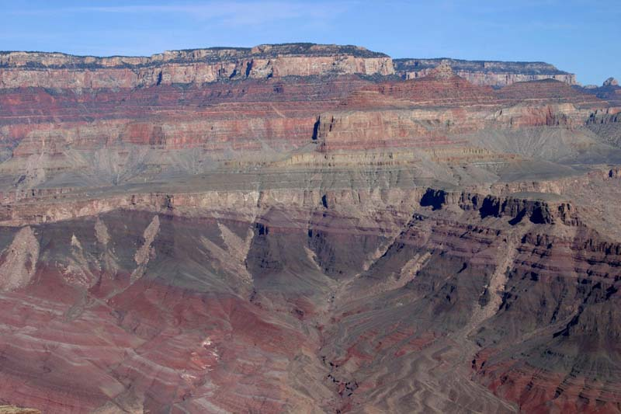
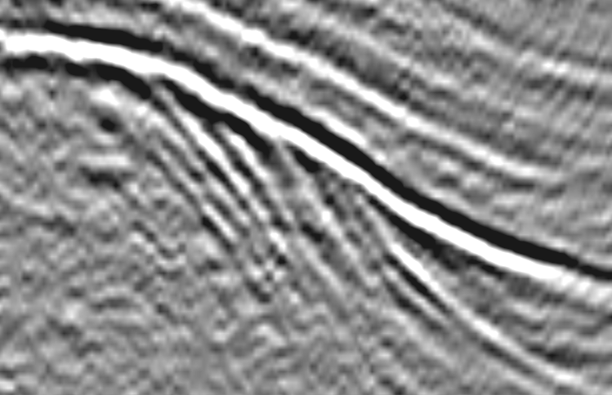


Geological features in seismic data
Angular unconformity - surface of erosion or non-deposition that separates younger less-tilted strata
from older more steeply dipping rocks
1
2
In the field (Grand Canyon)
In seismic data
(Cooper-Eromanga Basin, Australia)
3
4
Caused by: changes in sea-level and commonly tectonics

Slide 10
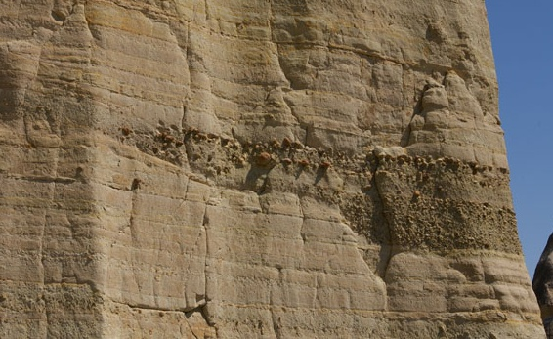
Geological features in seismic data
Down-cutting unconformity - surface of erosion or non-deposition that separates younger strata
from older rocks
In the field
In seismic data
Caused by: changes in sea-level (which may be caused by tectonics)

Slide 11
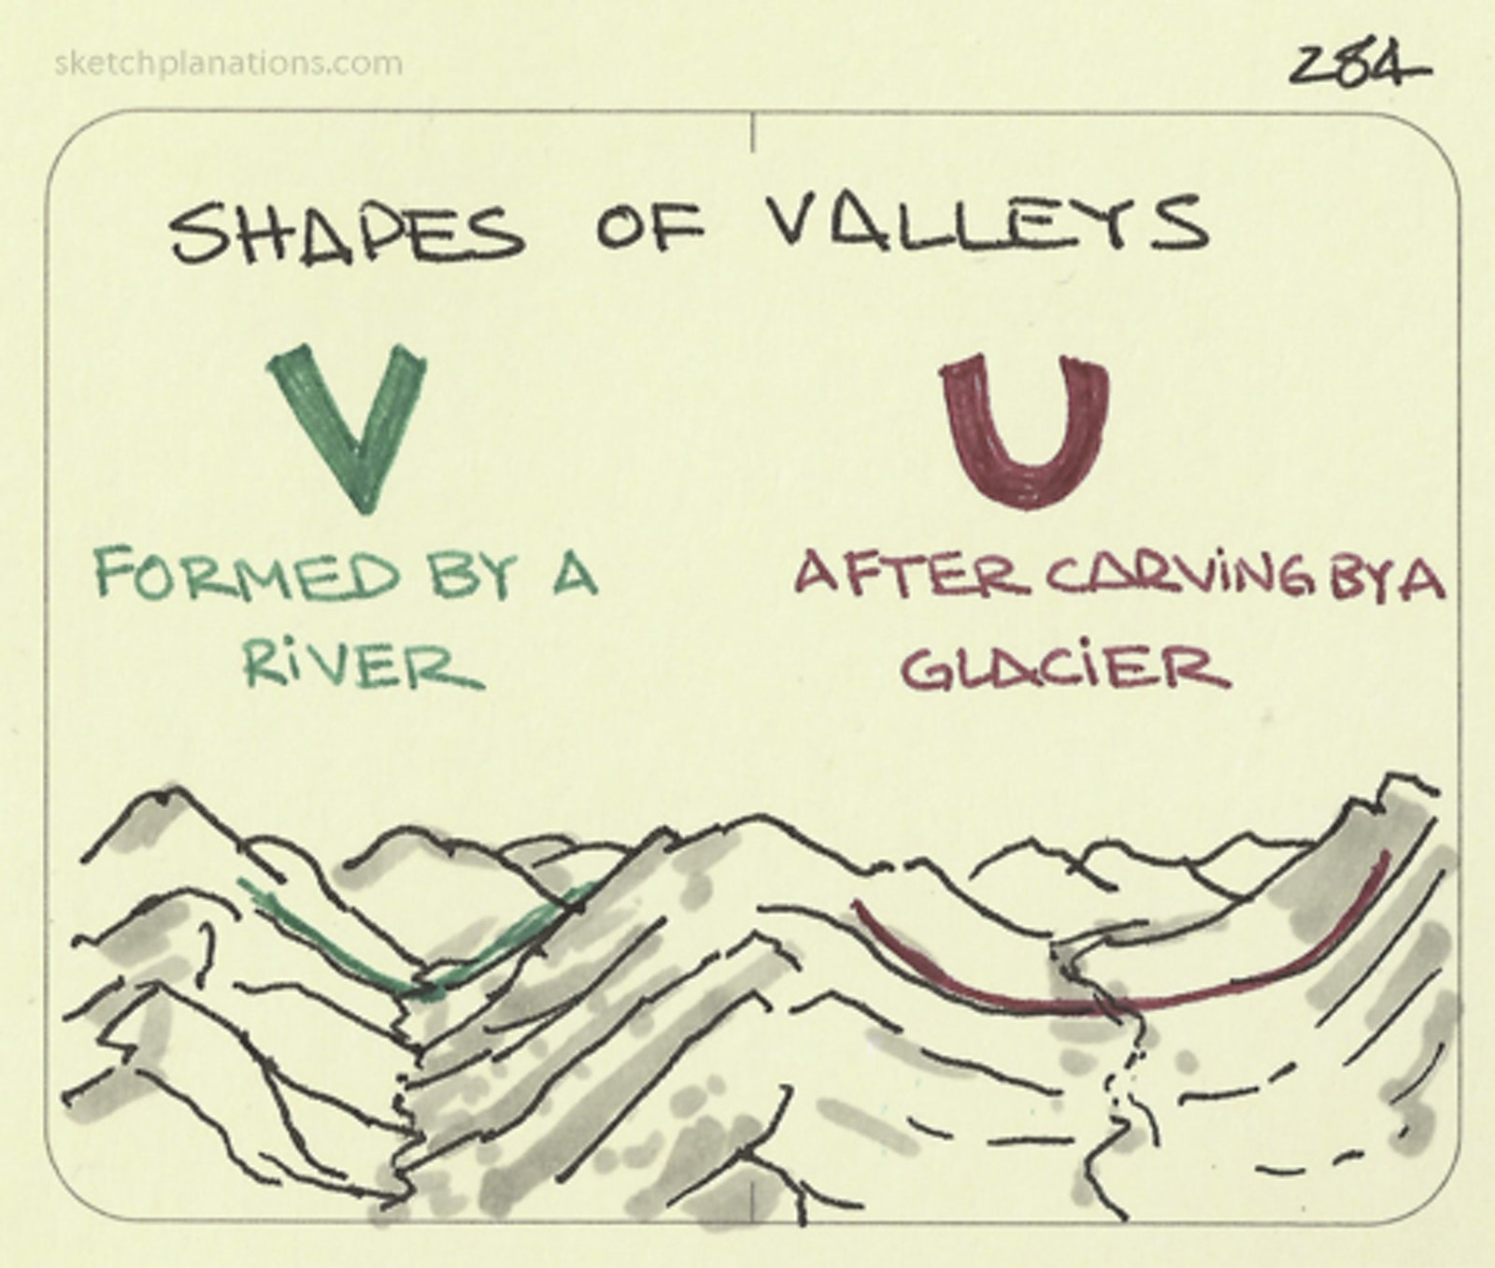
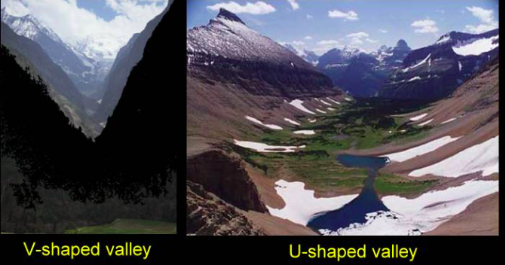
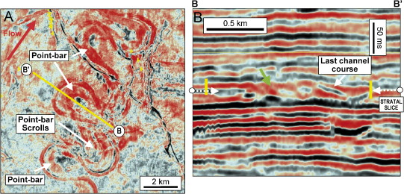
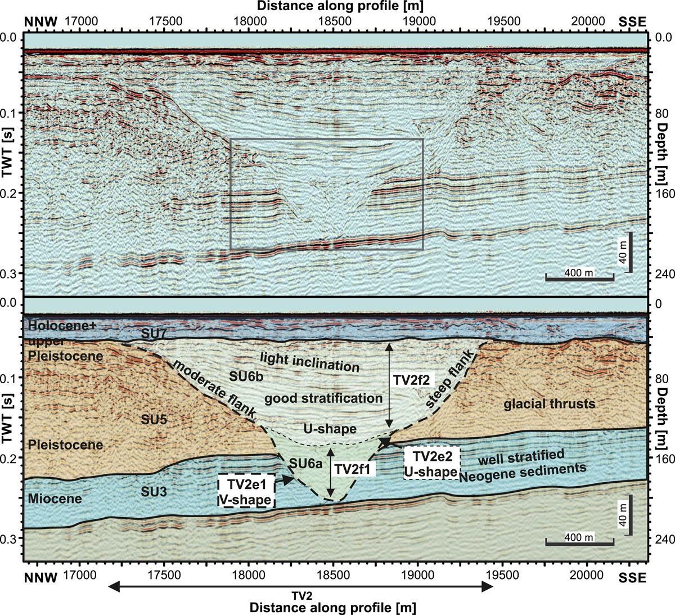
Geological features in seismic data
www.geocaching.com
www.sketchplanations.com
Lohrberg et al. 2020
Kolla et al. 2007

Slide 12
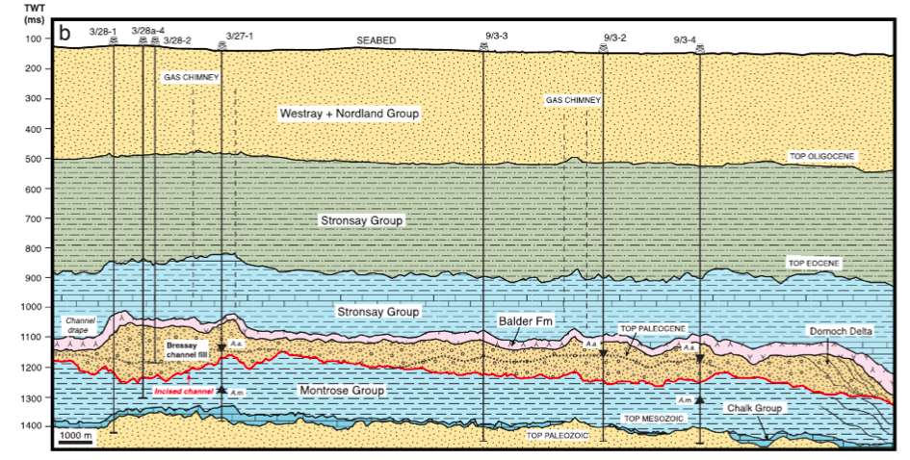
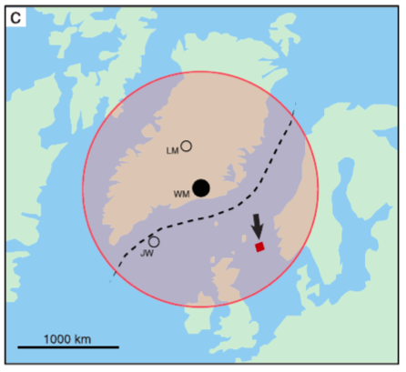
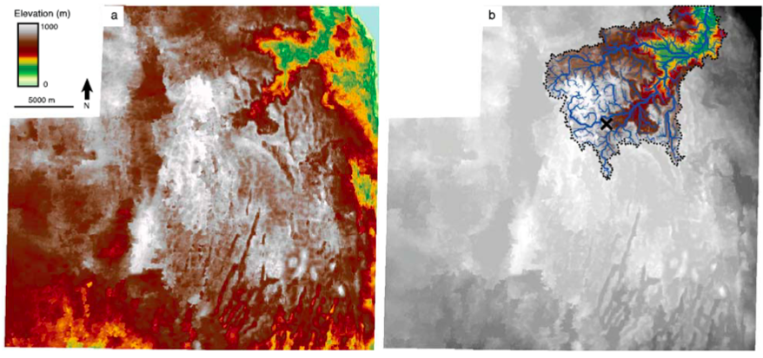
Buried drainage catchments in seismic data
Maps of horizons 55 million years old in some parts of the North Sea show evidence of that they were once sub-aerial drainage catchments that became rapidly buried by sediments (ie they are like fossilized rivers!)
These seismic horizon maps that reveal buried catchments can be used like DEMs and the same geomorphological tools Alex Lipp described on Monday can be applied
Stucky de Quay et al. 2017

Slide 13
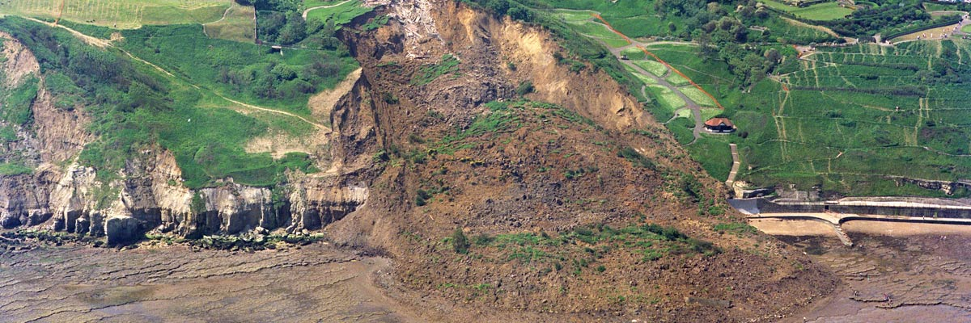
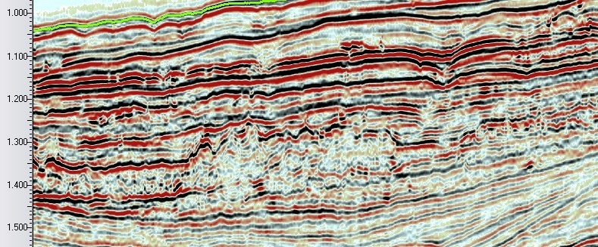
Geological features in seismic data
Mass transport deposits- sediment packages that move and deform under the influence of gravity-
Includes landslides, mudslides, submarine slides. Commonly form in multiple events
In the field
In seismic data
Offshore West Africa
Caused by: slope instability
(e.g. high rainfall, high pore fluid
pressure along slide surface)

Slide 14
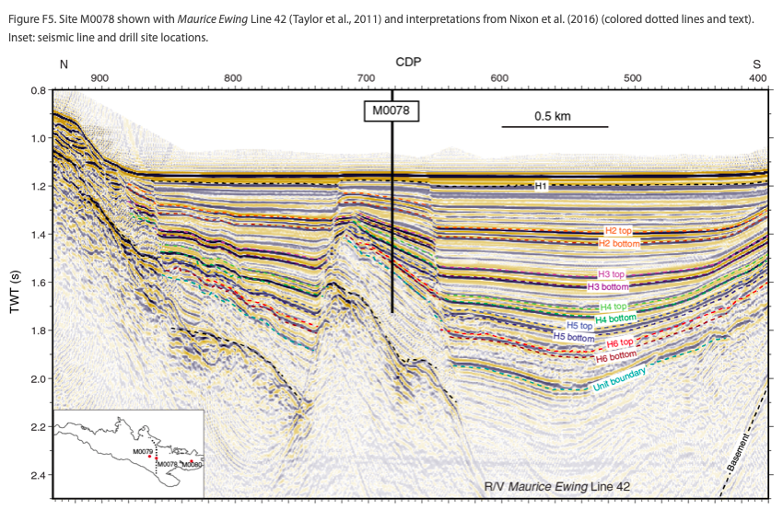
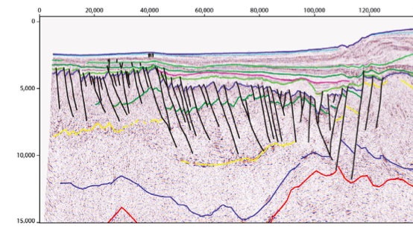
Geological features in seismic data
Active faults from the Gulf of Corinth, Central Greece
Inactive faults from NW Shelf Australia
Faults extend to the surface and offset young sediments
Faults are buried and haven’t deformed recent
sediments
McNeill et al. 2019
Earthquake hazard
Ion
Not a significant Earthquake hazard

Slide 15

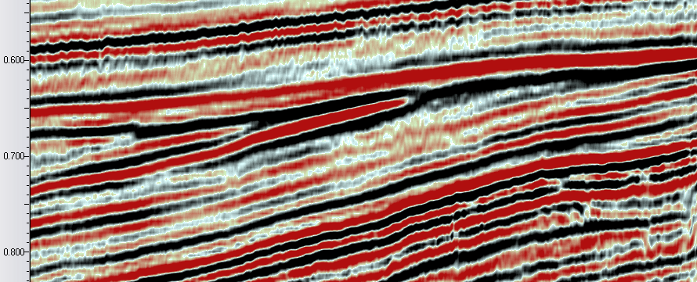
A
B
Describing what you see is more important than knowing the name of a geological feature…

Slide 16
Seismic interpretation deliverables
Time/depth-structure maps
Fault sticks
Maps of seismic facies (and ideally lithology/physical properties)
Attempts are being made to automate all of these processes

Slide 17
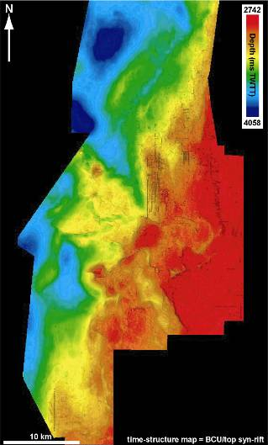
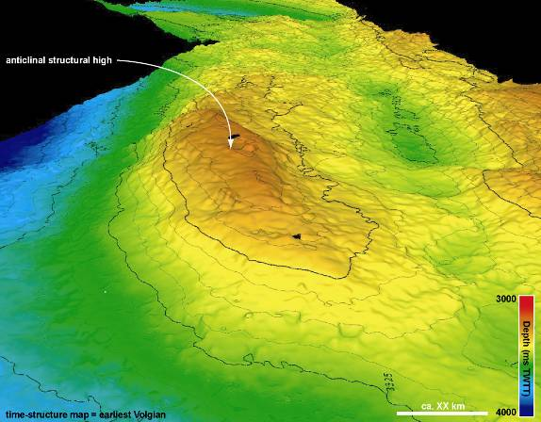
Structure Maps
c. 5 km
The key seismic deliverable
Can be either in time (time-structure map generated from time-migrated data) or in depth (depth map generated from depth-converted seismic data)
Can be displayed in 2D or 3D

Slide 18
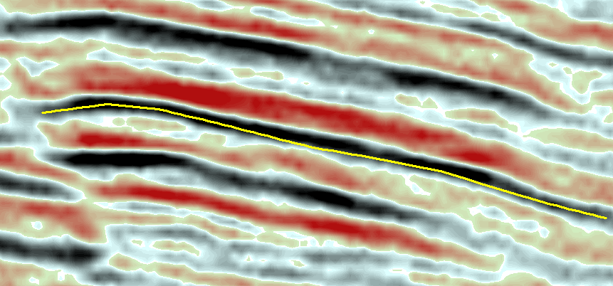
Picking Techniques
Manual or point-picking is a common method available on any interpretation platform. This is simply a point-and-click method and gives the interpreter full control over the location of the interpreted seismic horizons and is very useful in noisy datasets (see below). However, in this example to the left the interpretation does not sit directly on the reflection event of interest; this may result in some important geometric details being lost…

Slide 19
Picking techniques
In this example it would be preferable to utilise an automatic waveform tracking approach. In this method the software searches in a “window” centred around the previously picked point and chooses (if found) the seismic event which corresponds most closely to the first point.

Slide 20

Picking Techniques
In this example it would be preferable to utilise an automatic waveform tracking approach. In this method the software searches in a “window” centred around the previously picked point and chooses (if found) the seismic event which corresponds most closely to the first point. Note how the mapped horizon in the lower image more closely follows the reflection event than the upper image.

Slide 21
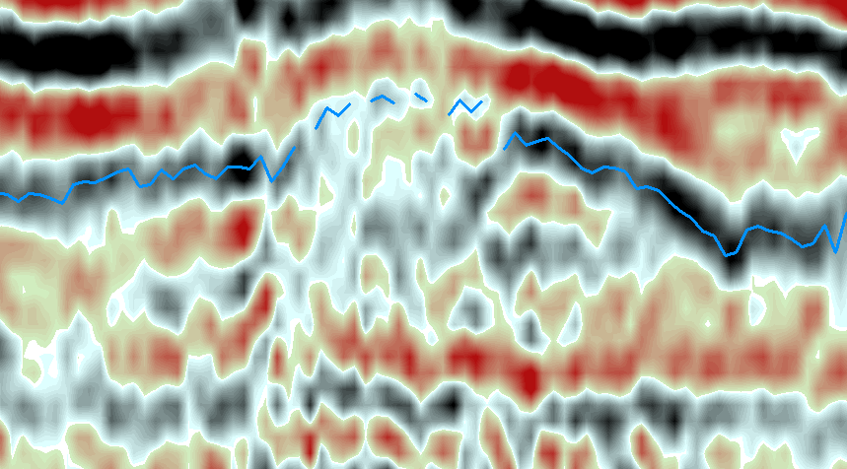

Picking Techniques
1) In some cases only manual picking will suffice, especially in areas where seismic data is noisy and reflection continuity is low. In the example to the left autotracking has managed to pick the majority of the event but has failed where noise occurs.
2) Point picking through the area of noisy data completes the interpretation. Having the geological knowledge (and bravery!) to utilise point-picking in certain parts of a dataset is a key skill to development.

Slide 22
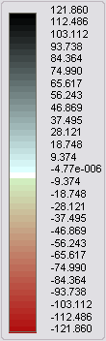
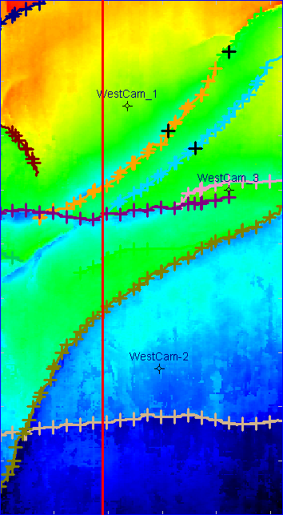
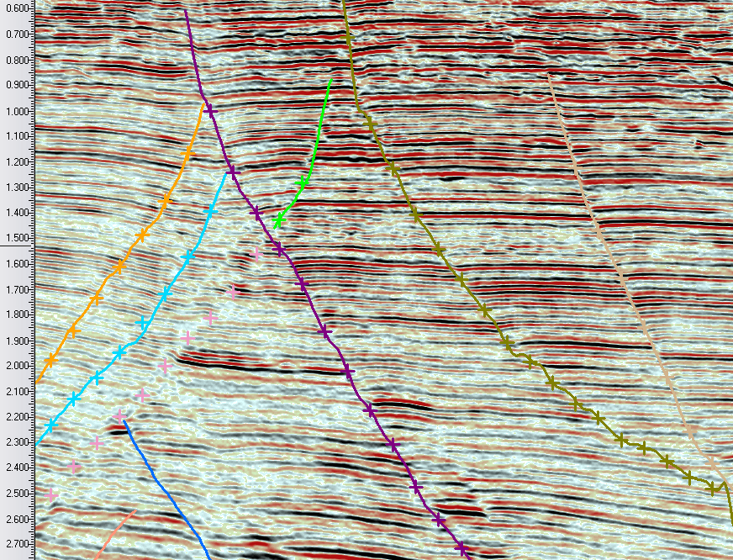
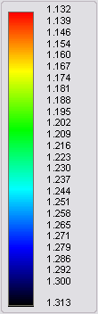
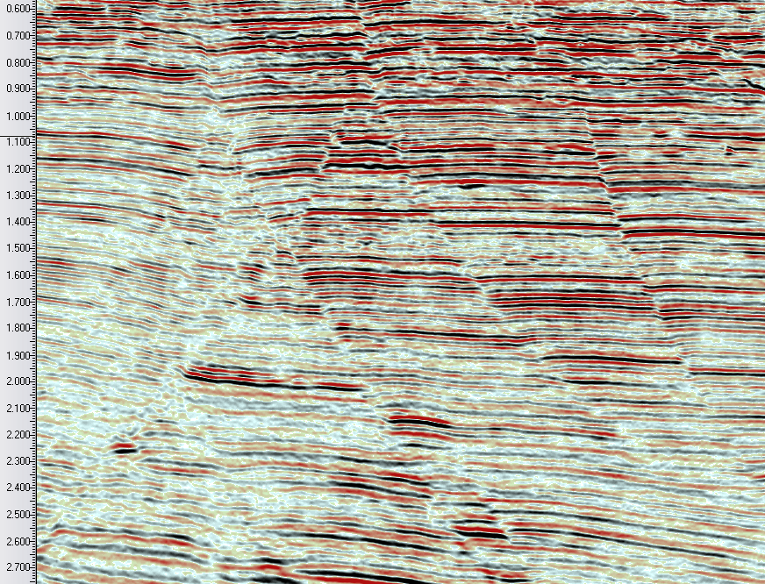
Fault Interpretation
Interpretation of faults in a Gulf of Mexico 3D seismic dataset. This is an example whereby the main focus of the interpretation is to define the regional-scale structure of the basin.

Slide 23
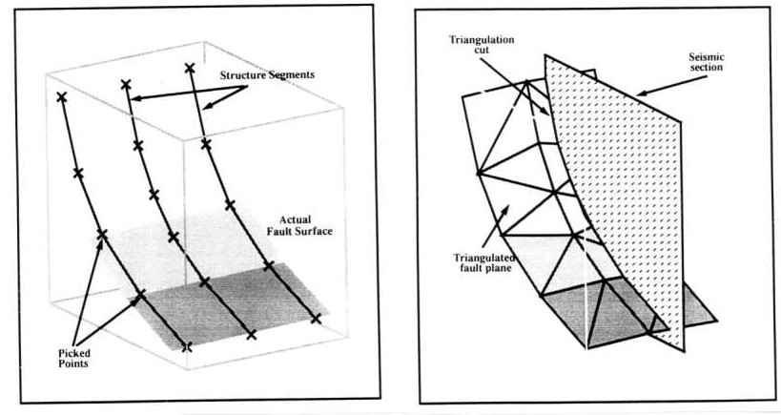
Fault Interpretation
Creation of a fault surface by triangulation and gridding of a series of fault sticks. These sticks are typically picked on seismic sections perpendicular to the fault but may also be picked on timeslices.

Slide 24
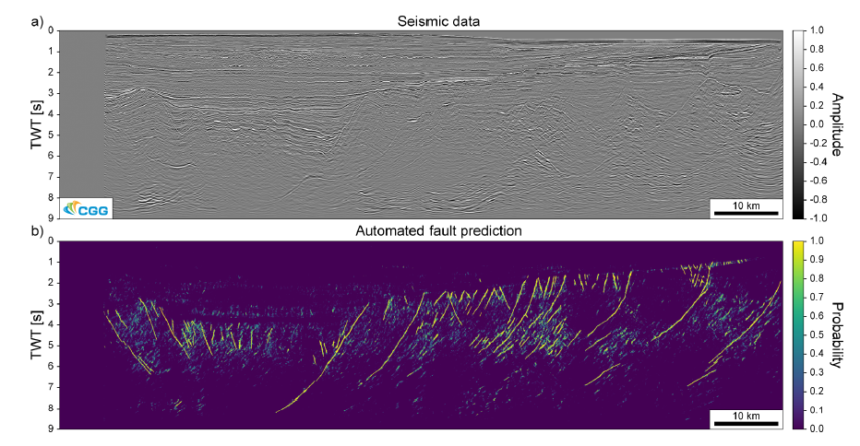
Machine learning- the future of interpretation?
In this example 10 seismic profiles through the 3D cube have been
Interpreted as “training data”
A python scripts treats the cube in small blocks and searches for things that look like the training data. These features are picked as in terms of the probability that they are faults
Example from Dr. Thilo Wrona (GFZ Potsdam), using data from CGG

Slide 25
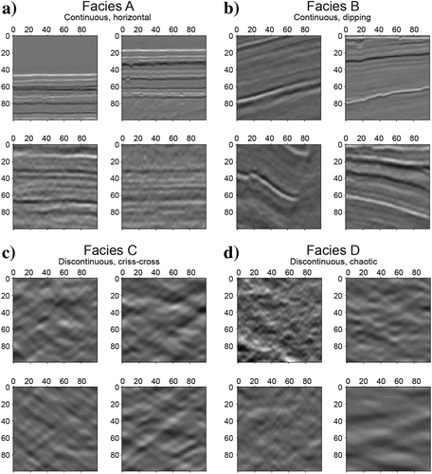
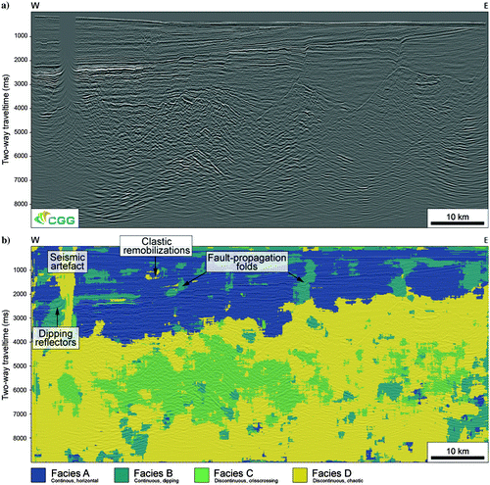
Seismic facies classifications
ML automated classification
after training
Manual seismic facies classification
Wrona et al. 2018

Slide 26
Learning outcomes
Understand that conventional seismic interpretation is very subjective and seismic facies are non-unique
Know how to recognise some key geological features in seismic reflection data
Appreciate the key conventional deliverables in seismic data interpretation and consider how data science may be able to contribute to (or revolutionise?) this field

